Slide 1
App Widget
Anjan Debnath

Slide 2
Android Widgets
Widgets are an essential aspect of home screen customization.
You can imagine them as "at-a-glance" views of an app's most important data and functionality that is accessible right from the user's home screen.

Slide 3
Widget types
Information widgets - weather widgets, clock widgets or sports score trackers
Collection widgets - a collection of pictures from a gallery app, a collection of emails/messages from a communication app.
Control widgets - music app widgets that allow the user to play, pause or skip music tracks from outside the actual music app.
Hybrid widgets - A music player widget is primarily a control widget, but also keeps the user informed about what track is currently playing.

Slide 4
Widget Creation Steps :
create layout for the widget.
create XML for defining the widget properties.
create class for the widget actions.
add all these to AndroidManifest.xml file.

Slide 5
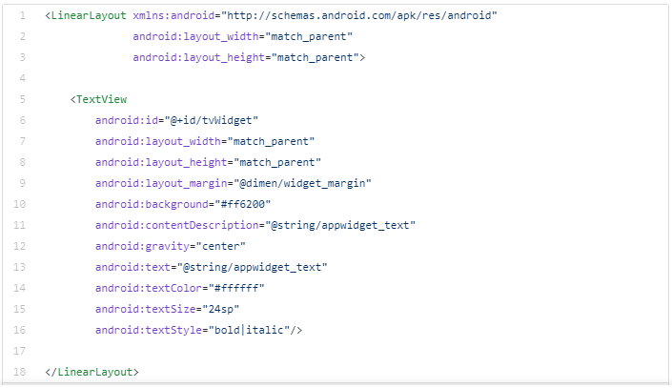
Step 1: Creating a very simple layout for a widget.

Slide 6
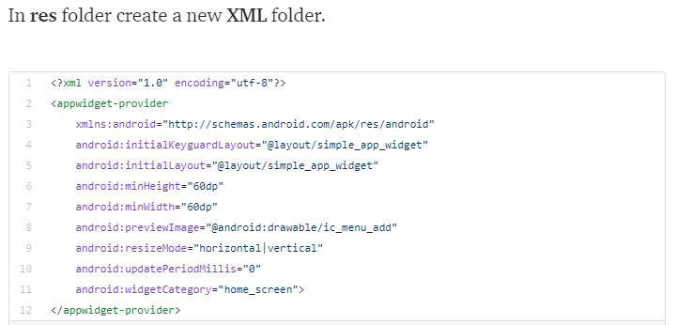
Step 2: create an XML that defines widget properties.

Slide 7
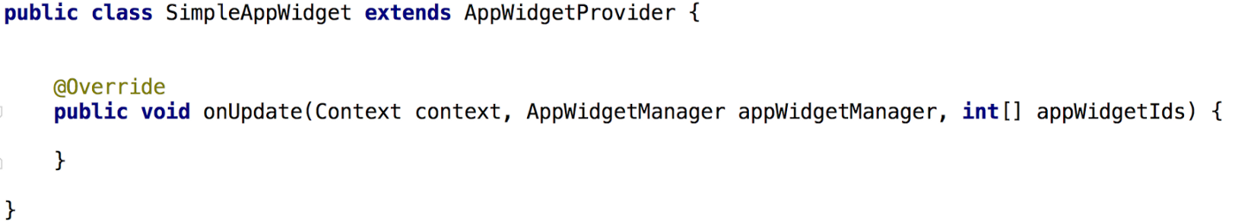
Step 3: Create a class for the widget lifecycle.
AppWidgetProvider extends BroadcastReceiver.
SimpleAppWidget is indirectly a child of BroadcastReceiver. So our widget class is a receiver class.

Slide 8
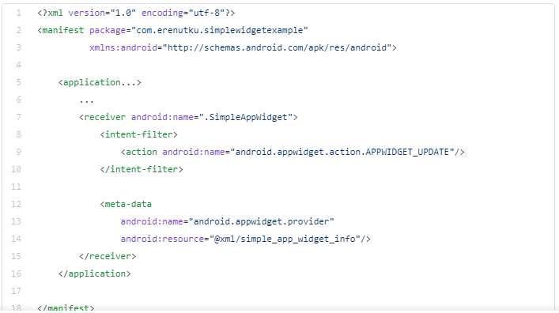
Step 4: Adding into AndroidManifest as a receiver.

Slide 9
Android Studio has an amazing interface for creating widgets.

Slide 10
References
https://medium.com/android-bits/android-widgets-ad3d166458d3
https://developer.android.com/design/patterns/widgets.html
https://developer.android.com/guide/topics/appwidgets/index.html
https://github.com/udacity/android-widget
https://medium.com/coding-blocks/creating-a-widget-for-your-android-app-1ee915e6af3e

